Slide 1

Genpact-Senority
Heineken
Wormer, 13 Mei 2013

Slide 2
Agenda
Introductions
Genpact opportunity @ Heineken Laurens
Senority opportunity @ Heineken Steve
Introduction Evaluetor Rolf
Brainstorm on joint proposition
Next steps

Slide 3
Heineken
Contract Management
Where We Are
Where We Need to Go
How to Get There
Zoeterwoude, October, 2012

Slide 4

Agenda
OGSM overview
Contract Management Scan
Initiate improvement programs per OpCo
Global Contract Management Solution
Next steps

Slide 5
Objectives, Goals, Strategies and Measures (OGSM)
Objectives
Goals
To ensure that Heineken Contract Management systematically and efficiently manages contract creation, execution and analysis for maximizing operational and financial performance and minimizing risk
Awareness
Standardize processes
Implement Contract Mgmt. System
Reactive
Optimize Suppliers based on Kralijc
Proactive
Dashboards, alerts and compliance and reduction of risks
Managed
Center led contract management
Optimized
Quality of Service delivered
Strategies
Baseline Heineken Cm operations (perform CM Scan) NL & others
Initiate improvement programs per OpCo
Adapt global model to incorporate OpCo requirements
Install global contract management solution
Heineken Global Procurement
Contract management departments
Install continues improvement process
Measures (Evaluetor)
Contracts: Contract Performance Indicators (CPI)
Relationship Management: Key Performance Indicators (KPI)
Service Levels: Service Performance indicators (SPI)
Improvement Management: Improvement Status Indicators (ISI)

Slide 6

OpCo Contract Management Lifecycle
Improvement
Programs
(from Scan)
Strategic Action Plan
Implementation
Measure
Evaluate Results
OGSM
CMM
Contract Management Scan NL
Execution of the Contract Management lifecycle…
connects the strategy to the plan for Heineken

Slide 7
Agenda
OGSM overview
Contract Management Scan
Initiate improvement programs per OpCo
Global Contract Management Solution
Next steps

Slide 8
Objectives for Contract Management Netherlands
Understand the current position (maturity level) of contract management for both product related and non-product related contracts
Baseline measurement (“nulpunt meting” Dutch wording provided for clarity)
Additionally, understand the current position of Heineken’s competitors as well as other food and beverage company’s (e.g. Nestle, Danone, etc)
Design an action plan to move from the current maturity level to next level and beyond
“What are the required steps”
Create opportunities for cash through improved Ts & Cs compliance, security and control of strategic and bottlenecked suppliers, improvement of integral costs as well as value engineering
Continuous improvement for security of supply, suppliers, compliance and in comparison to competitors
This is the end game for contract management to reach this level, Cooperation

Slide 9
Contract management Scan© Baseline for Measurement
The Contract management Scan©
determines the maturity level for the Contract management function within the Heineken Nederland organization.
includes all relevant questions to plot the Contract Management function (as-is) and presents the possibilities for improvement. It also shows the “low hanging fruit”.
expects that the Contract management function, similar as other functions within the organization, needs to develop conform a growth model.
Therefore:
It delivers results that are measureable
which leads to projects with defined goals
that drive savings and cash to the bottom line

Slide 10
A Capability Maturity Model for Good Contract Management Aligned with Heineken’s Plans
Level 4:
Cooperate
Cooperate
Focus of Contract management on continuous improvement of services and exploration of new possibilities to cooperate
Sourcing strategy aims at long term cooperation with suppliers
Governance structure guarantees optimal and durable cooperation.
Excellent working relations between key players on client and supplier side on every management level
Supplier management is governed by the corporate strategy
Level 3:
Manage
Manage
Service delivery according to agreed service levels
Contract management part and parcel of the sourcing strategy and procurement processes.
Incident-,Problem- en Risk management processes are operational.
Periodic evaluation of contracts and suppliers
Level 2:
Control
Control
Central contract registration and storage
Contract administration is operational and responsibilities are clear.
Central registration of financial commitments as part of the general ledger system
Suppliers are incidentally consulted.

Slide 11
The Questionnaire Drives Results
Based on the questions per area shown below, the level of maturity of the as-is organization is determined
The scan identifies improvement projects regarding actions to achieve the next level of maturity and beyond
Measurement Areas for Good Contract Management

Slide 12
Contract Management Scan©: The Results (example)

Slide 13
Agenda
OGSM overview
Contract Management Scan
Initiate improvement programs
Global Contract Management Solution
Next steps

Slide 14
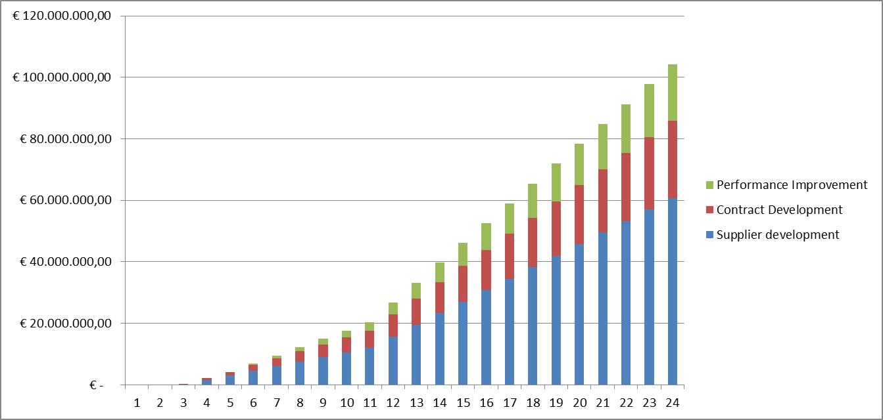
Opportunities for Hard Cash
Using the results from the spider diagram a defined set of improvement projects will be defined, delivering the following savings:
Supplier Development Project
Analysis of the Suppliers shows improvement areas for alignment and contract improvements yielding higher quality
2% overall cost reduction within 3 months with up to 5% total cost reduction within 1 year
Contract Development Project
Contracts are analyzed and show discounts are being lost due to contractual terms and conditions not being used
Increased savings from discounts captured of 5% within 1 month, 10% within 6 months and up to 20% within 1 year
Performance Improvement Project using Evaluetor©
Performance analysis using Evaluetor using a system of dashboards and alerts allows for proper management of contracts that have not been previously managed due to SLAs not being adhered to
3% cost savings within 6 months and up to 8% within 1 year
24 Months Cumulative Savings Potential
for the 3 Project Areas (estimated)

Slide 15
Agenda
OGSM overview
Contract Management Scan - SCAN’s
Initiate improvement programs per OpCo
Global Contract Management Solution
Next steps

Slide 16
Heineken Contract Management Moving from Local to Global
Increase maturity of contract management through OGSM
Contract management organized the same for each OpCo, targeted information distribution
Active contract management via alerts
Managing of Client and Supplier compliance
Financial control
Supplier performance management
Analysis of cost savings
Value engineering
Leverage the benefit of HEINEKEN’s “global scale” is clearly defined as strategic business priority
Ambition to shift from Local to Buy-Sell
Proactive Stakeholder management is considered fundamental

Slide 17
Measureable & Achievable Improvements
Help organisations get what they contracted
Real time Contract and Relationship monitoring
Common global methodology and toolset
Closer and more intimate Supplier and Client relationships that are:
Transparent
Honest
Both parties (Contract Management and their counterparts) deliver on agreed commitments
Pro-active
Immediate action when required
Evaluetor© makes complex business relationships transparent, measurable and actionable
Proven concepts converted in solid repeatable solutions
Designed to manage geographically dispersed organisations

Slide 18
Introducing the Evaluetor© Concept
Delivery (SLA) & Projects Performance
Service
Performance
Indicators
initial focus
Contract
Event
Action
Log
Contract
Management
Relationship Management
Contract
Performance
Indicators
Key
Performance
Indicators
Improvement
Status
Indicator
Improvement Management

Slide 19
Evaluetor©: Continuous Improvement Process
This will bring insight and visibility on the quality of your services and perceived value
Improved collaboration between Contract Management and their Suppliers
Shared dash-boarding;
Focused on the relationship;
Internal perception recording;
Transparent Supplier relationship with aligned expectations
Supplier performance measurement;
Trusted relation
Early identification of issues and opportunities;
Making informed decisions
Pro-active global governance;
Reliable revenue predictions;
Automated contract alerts;
One corporate “language”;
Key performance indicator monitoring;
De-risked backlog
Real time relationship monitoring.
More reliable outlook
Better contract performance
De-risked portfolio
More savings with existing suppliers
Decrease operational cost

Slide 20
How the Information Comes Together
Evaluetor Dashboard
Contract performance
Improvement
Plan Status
Contracts
Upload
Contracting (client & supplier)
Go to Green status collection
Services Metric collection (SPI)
Delivery Performance
Project
Metric
Collection
Alerts
Account Staff
Delivery Staff
Supplier Team Score
Client Score
Client Interview
Web based Survey
Perception based
Fact based

Slide 21

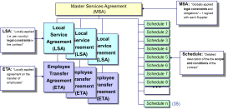
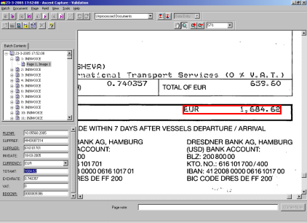

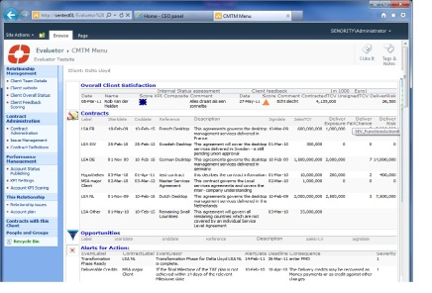
How to Get Your Existing Contracts into Evaluetor©
Contract documents are tagged with relationship attributes
Enrich DB with contract details
Analyse contract clauses and register relevant Alerts
Contract documents
Evaluetor
DB
Digitise
Categorise
Enrich
Add Alerts
Scan and/or copy contract documents into Evaluetor Document Library
Electronically relate contracts and associated schedules per relation
Add first level information like end date, type of services, etc.
Add contract specific information that is required to manage the contract more effectively

Slide 22
Agenda
OGSM overview
Contract Management Scan - SCAN’s
Initiate improvement programs per OpCo
Global Contract Management Solution
Next steps

Slide 23
Next Steps
Gain support of Ruth Bromley
Meet with Frans Eusman to explain the proposal
Start the Contract Management Scan (CMS) in NL – November 2012
Prioritize performance improvement projects in NL
Start NL improvement projects
Start other OpCo’s CMS – January 2013
Start NL Evaluetor implementation – January 2013
Start other OpCo’s improvement projects – April 2013

Slide 24
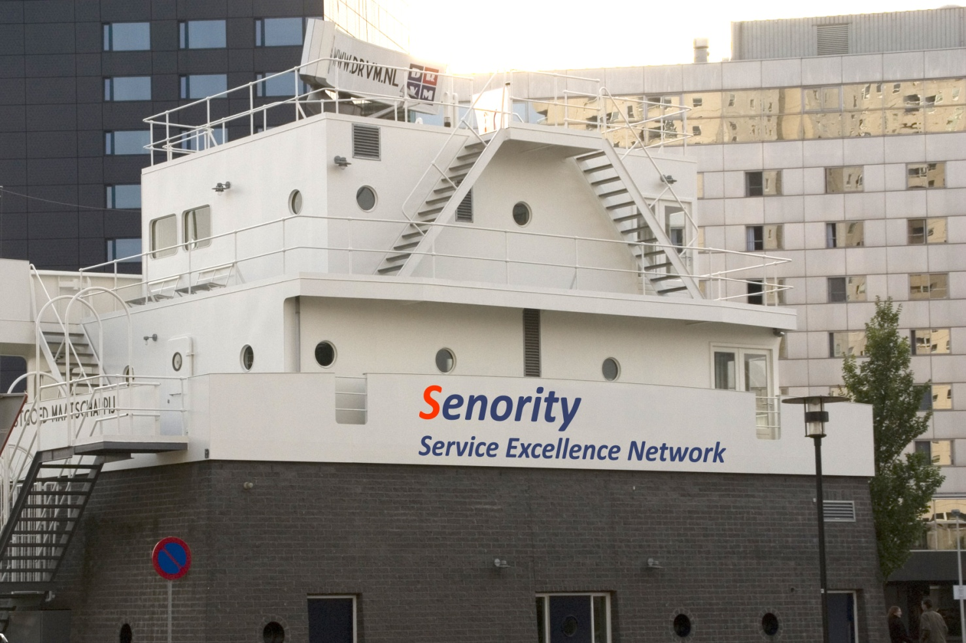
Contact
Steve Koutros
Steven Visser
Managing Partners - Senority Boompjes 680 3011 XZ Rotterdam
The Netherlands Tel: +31 (0) 10 217 0118 Fax: +31 (0) 10 213 0133 Mobile: +31 (0) 631003495 Steven.Visser@senority.nl www.Senority.nl

